Slide 1
The Boiler Room
What did you observe? What questions do you still have?

Slide 2
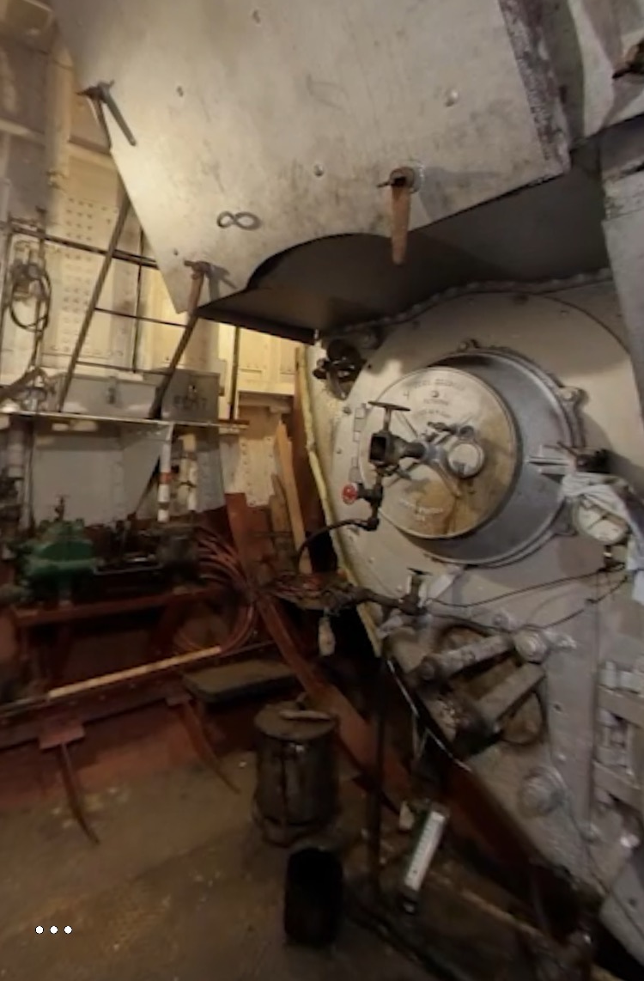
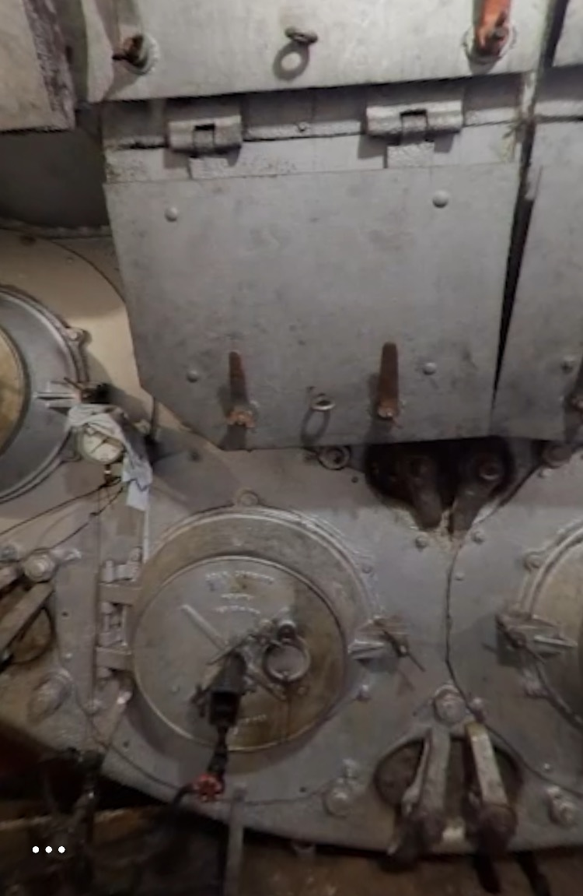
The Boiler Room #2
In the boiler room, fire heats up water. What happens when water is heated? Let’s find out!
🔥 + 💧 = ???

Slide 3
Experiment
Observe closely as your teacher heats up water in the beaker using fire. What do you observe? Write about and draw your observations!
How do you think this experiment connects back to what is happening in the boiler room?
Observational Drawing
Accurate Big Colorful Detailed Explained (includes labels)
Notes:
Experiment: Turn on the burner. Using tongs, place a beaker full of water over the fire. Allow students to observe the water converting to steam. In the boiler room, water is heated with fires so that it is converted to steam.

Slide 4
Class Share
What did you observe?
What do you think is happening?
How does this relate back to Hercules’ boiler room?

Slide 5
The Boiler Room #3
We learned about what happens in the boiler room. Let’s zoom in even more to see what’s happening!
🔥 + 💧 = ???

Slide 6
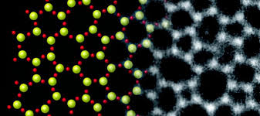
Molecules
Molecules are the smallest unit of matter.
Everything around us is made of molecules, but they are so small that our eye can’t see them.
How small are molecules? Let’s check it out with the Amplify Scale Tool!
In science, molecules are shown by tiny circles. In real life, molecules look a little different.
What is happening at a molecular level when water is heated to create steam? Let’s find out!
real life
drawing

Slide 7
Simulation
Observe closely as you add heat to the water molecules. What happens? Pay special attention to the speed and size of the molecules as they convert from water to steam.
I notice that the speed of the water/steam molecules…
I notice that the space between the water/steam molecules…
What do you observe? Write about and draw your observations!
Notes:
Students should observe that the steam molecules get faster and that there is a more space between them.

Slide 8
Class Share #2
What did you observe?
What do you think is happening?
How does this relate back to Hercules’ boiler room?

Slide 9
Energy
Energy is all around us! Energy can be stored in things. It can also be used to make things change and move.
We have energy stored in our food. We use that energy when we run and play!
Here are some types of energy:
Chemical energy: energy that is stored in chemicals and is involved in reactions.
Heat (thermal) energy: energy in the form of heat.
Mechanical (motion) energy: energy in the form of movement.
When do you see these forms of energy in your everyday life? Can you think of other types of energy you see?
Notes:
Other examples of energy in our everyday life: chemical energy is in our food, heat energy comes from our classroom heaters, when we breathe out we release some heat energy, mechanical energy is used when we run around.

Slide 10
Energy Transfer
Energy comes in all forms! Some examples are heat energy, electrical energy, sound energy, and light energy.
Energy can be transferred, or converted, from one form to another.
When we eat food and then move around, we transfer chemical (stored) stored in food to mechanical (movement) energy.
When we use a toaster oven, we transfer electrical energy from the wires in the wall to heat energy to toast our bread.
Can you think of another time in your everyday life where you see an energy transfer?
Notes:
Prompt students to think of microwaves, irons, heaters, etc.

Slide 11
The Boiler Room #4
🔥+ =
🔥 + 💧 = 💦

Slide 12
Energy Transfer #2
What kinds of energies are involved in this transfer process? How do we know?
I think that...is transferred to...I think this because…
From the fire, there is...From the steam molecules, there is...The transfer of energy is...to...
Word Bank
Heat energy Mechanical (movement) energy Chemical Energy
Notes:
Students might state: From the fire, there is heat energy. From the steam molecules, there is mechanical energy. The transfer of energy is heat energy to mechanical energy.

